Slide 1
State Pattern
Torpedo Tube Application
Kyle Breen-Bondie
CIS 476
3.15.26

Slide 2

Background:
Submarine Game
Python game (Originally a board game)
Played through console
Player controls a submarine

Slide 3
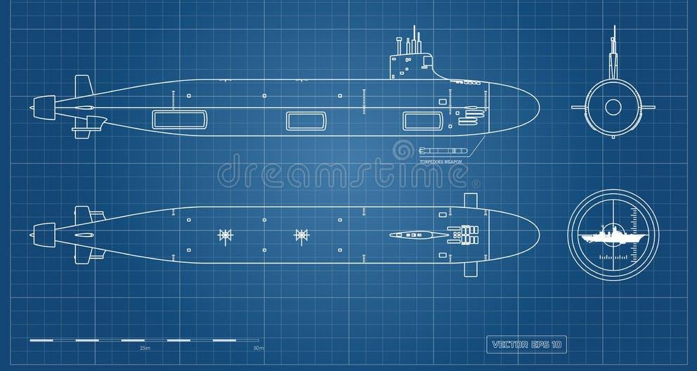
Intent
Recreate and improve torpedo tubes & logic using state pattern
Tubes exist within “banks” -ie “Starboard Fore”
Tubes Banks can be operational, inoperable or broken
Individual Tubes have operations like fire( ), load( ), repair( )

Slide 4
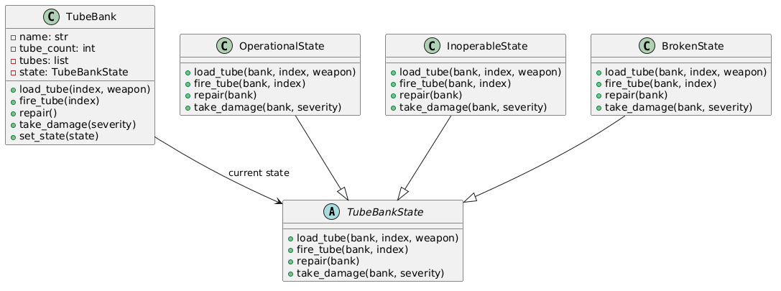
Class
Diagram

Slide 5
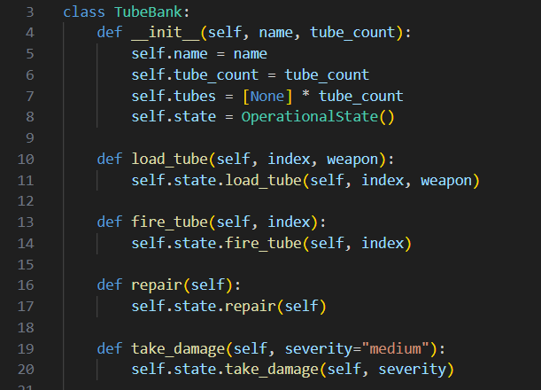
TubeBank Class
Group of torpedo tubes from the same side/location
Responsible for storing bank’s shared data, like name, tube count, etc.
Methods delegate behavior to current state

Slide 6
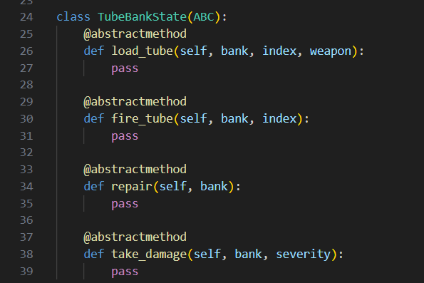
TubeBankState
Abstract state class
Defines the structure that every state must follow
Gives states all the necessary operations

Slide 7
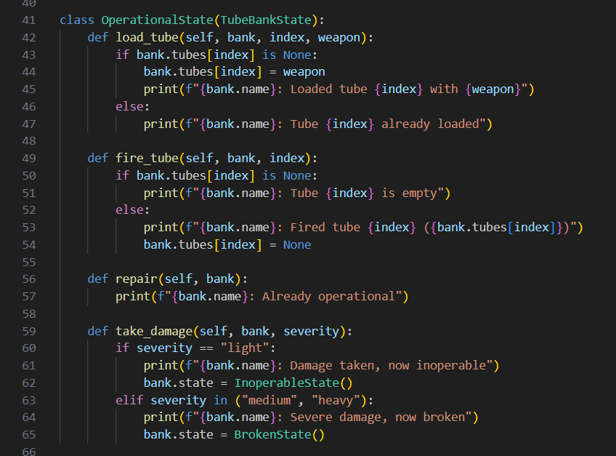
Concrete States
3 concrete states are defined:
Operational
Inoperable
Broken
Operational is normal, working state that allows for function
Inoperable and broken are varying degrees of damage that disallow things like loading and firing

Slide 8
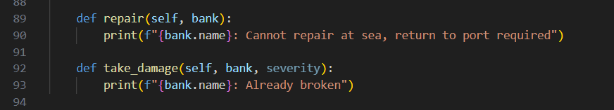
State Transitions
States can change via take_damage( ) or repair( )
The current state controls the action taken
Ensures the correct action is taken (can’t repair an already operational tube)

Slide 9
Advantage, Disadvantages & Applications
+
-
Removes cumbersome conditional logic
Behavior is determined at the state / condition level
Easy to add states
Overly complicated for small systems
More classes
Less obvious / harder to follow at first glance
There are several real world applications that have states that control behavior. Some other examples:
Turnstile
Vending Machine
Elevator
Traffic Light
Online Ordering System (Order Status)
Video Games

